Slide 2
HIV Testing and Management in the era of PrEP
HIV testing: updates and challenges
Bernard M Branson MD
@TwitterHandle
Share your thoughts on this presentation with #IAS2019

Slide 3
Background and Disclosure of Financial Relationships
Dr. Branson previously served as Associate Director for Laboratory Diagnostics in CDC’s Division of HIV/AIDS Prevention until October 2014.
Dr. Branson currently serves as consultant to the Gilead Sciences FOCUS Program and Chembio Diagnostic Systems, Inc.

Slide 4
Use of Brand Names
This presentation will refer to individual HIV tests by brand name for the purposes of identification and clarity.
No endorsement of any specific test is intended.

Slide 5
Evolution of HIV Tests
1st generation: whole viral lysate, detects IgG antibody
2nd generation: synthetic peptides, detects IgG antibody
3rd generation: detect IgM and IgG antibody
4th generation: detects IgM, IgG antibodies, p24 antigen

Slide 6
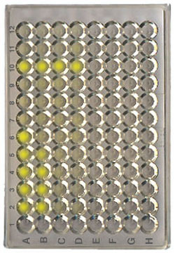
1st and 2nd Generation: Indirect EIA
Plasma/serum
(1 h/37º C)
HIV antibody
Plasma/serum
IgG
IgM
Antigen
1st - Viral lysate
2nd – Recombinant proteins or synthetic peptides
Enzyme label
Detection
Anti-human IgG
Color change with HIV IgG
Color
reagent
IgG

Slide 7
3rd Generation: Sandwich EIA
Plasma/serum
(1 h/37º C)
HIV antibody
Plasma/serum
IgG
IgM
Enzyme label
Antigen
1st - Viral lysate
2nd – Recombinant proteins or synthetic peptides
Enzyme label
Antigen
Recombinant proteins or synthetic peptides
Detection
HIV antigen
Anti-human IgG
Color change with HIV IgG or IgM
Color
reagent
IgG
IgM

Slide 8
4th Generation: Sandwich EIA
Plasma/serum
(1 h/37º C)
p24 Ag
Monoclonal anti-p24 antibody
HIV antibody
Plasma/serum
Enzyme label
Antigen:
Recombinant proteins or synthetic peptides
Detection
anti-p24
HIV antigen
Color change with HIV IgG, IgM or p24 Ag
Color
reagent

Slide 9
Rapid Tests: which generation?
HIV antibodies
Plasma/serum
(1 h/37º C)
Colloidal Gold
Plasma/serum
Blood, oral fluid
Protein A
IgG antibodies
Protein A binds to IgG, ± IgM
Control
Anti-human IgG
HIV Antigen
Recombinant proteins or synthetic peptides
(Indirect IA)

Slide 10
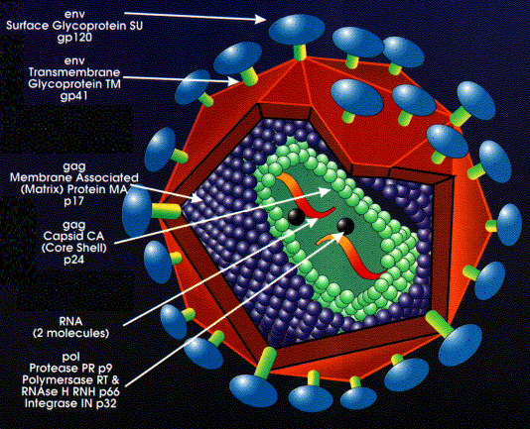
HIV-1: viral antigens and RNA
gp120
gp 41
p24
RNA

Slide 11
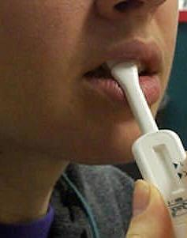
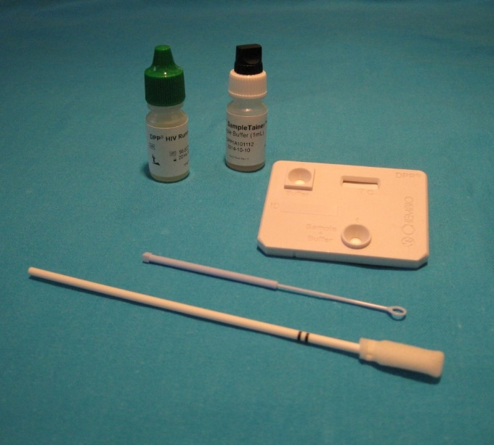
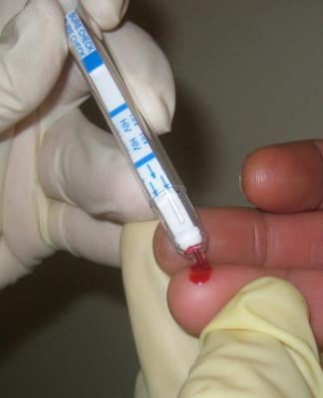
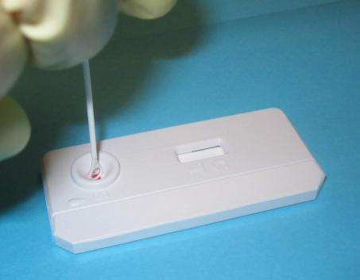
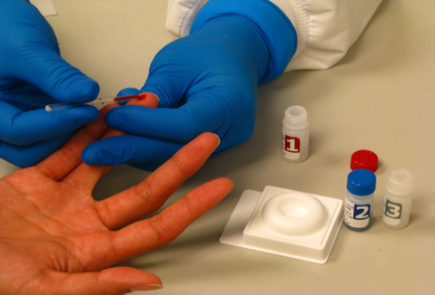
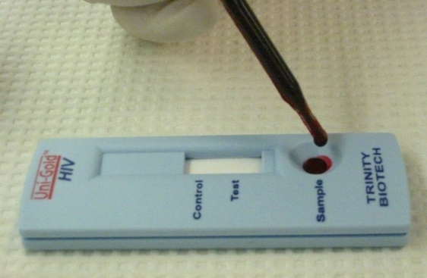
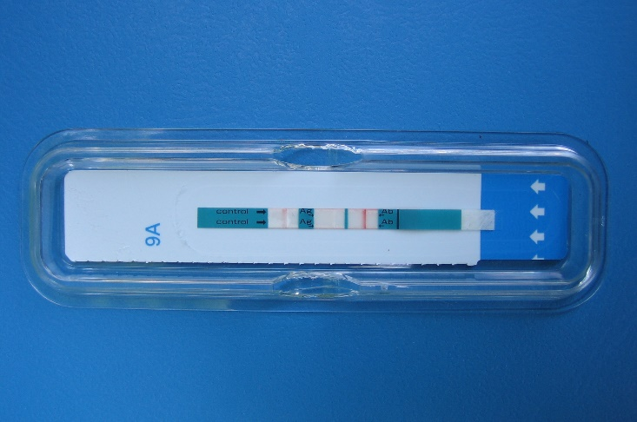

Which HIV antibodies do rapid tests detect?
gp41
gp41, gp120
gp41, gp120
gp41, gp120
Oraquick Advance
DPP HIV 1/2
Chembio Sure Check
Chembio Stat Pak
gp41
gp41, gp120
gp41, gp120
INSTI HIV 1/2
Uni-Gold Recombigen
Determine Combo Ag/Ab

Slide 12
Which test is currently used most often to detect HIV infection?
CIA – Chemiluminescent Immunoassay
DIA – Defense Intelligence Agency
EIA – Enzyme Immunoassay
MFI – Multiplex Flow Immunoassay
None of the above

Slide 13
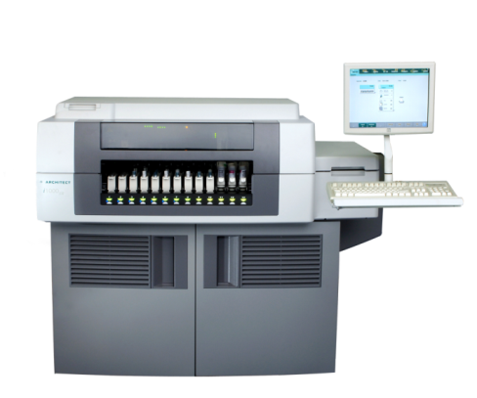
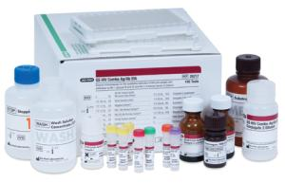
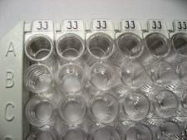
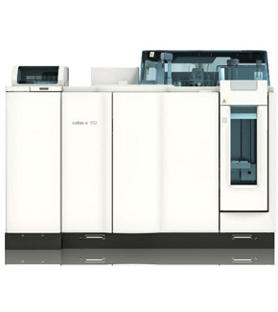
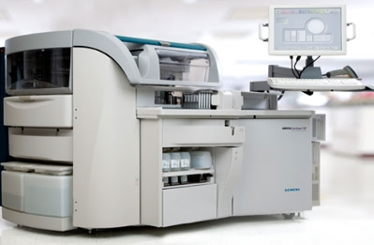
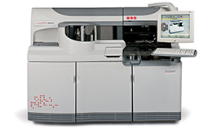
EIA
CIA
Bio-Rad Ag/Ab Combo EIA
2011
Abbott Architect Ag/Ab Combo
2010
CIA
CIA
CIA
Siemens Advia Centaur® CHIV
Elecsys HIV combi PT
VITROS HIV combo
2015
July 2017
Dec 2017

Slide 14
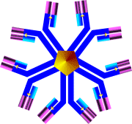




Chemiluminescence Immunoassays
Magnetic
Micro-Particles
Coated with Antigens
and antibody
Serum/plasma
Light Reagent
Antigens and antibodies
labeled with AE
S
B
gp41/120
Ag
gp41/120
Ag
gp41/120
Ag
AE
S
B
B
WASH
gp41/120
Ag
AE
gp36
Ag
AE
WASH
gp36
Ag
S
B
B
HIV1 “O”
Ag
AE
HIV1 “O”
Ag
S
B
B
Trigger Solution
IgM/IgG
AE
S
B
Chemi-
luminesce
p24
Ag
AE
Αnti- p24
Monoclonal
Αnti- p24
Monoclonals
Relative light units

Slide 15
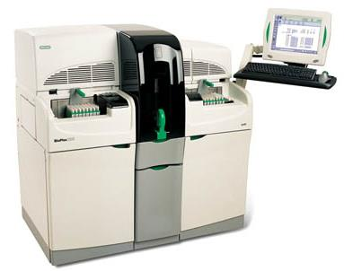
Multiplex Flow Immunoassay: Bioplex HIV Ag/Ab Combo
Beads conjugated to HIV-1 Group M and O antigens, HIV-2 antigens, and p24 antibody
Distinguishes between
  p24 antigen
  HIV-1 antibodies
  HIV-2 antibodies
2015
  HCV
  RPR and Treponemal syphilis
“Fifth Generation”

Slide 16
New terminology
Instrumented lab test
Single-use rapid test

Slide 17
Antigens used by instruments to detect HIV-1
“3rd generation” instrumented antibody tests
Bio-Rad GS HIV-1/2 Plus O | p24, gp160
Ortho Vitros Anti-HIV 1+2 | p24, gp41, gp41/120
Siemens Advia Centaur HIV 1/O/2 | p24, gp41/120
“4th generation” instrumented Ag/Ab combo tests
Abbott Architect HIV Ag/Ab Combo | gp41
Bioplex 2200 HIV Ag-Ab | gp160
Bio-Rad GS HIV Combo Ag/Ab | gp41, gp160
Ortho Vitros combi | gp41, gp41/120
Siemens Advia | gp41/120
Roche Elecsys | gp41, RT
Just like single-use rapid tests

Slide 18
Sequence of Test Positivity Relative to WB (plasma)
166 specimens, 17 Seroconverters - 50 % Positive Cumulative Frequency
Bio-Plex Ag/Ab Combo
Ortho Vitros
Determine Ag/Ab Combo
Architect Ag/Ab Combo
Bio-Rad Ag/Ab Combo
Advia Centaur Ag/Ab
SureCheck HIV-1/2
Reveal G3,
Window Period
HIV-1/2 STAT-PAK
Advia Centaur
DPP
GS 1/2+O
APTIMA
INSTI
OraQuick
Multi-Spot
Unigold
WB positive
25
20
15
10
5
0
Days before WB positive (50% Cumulative Frequency)
Delaney et al, Clin Inf Dis 2017

Slide 19
Timeline of Laboratory Markers
HIV RNA (plasma)
Fiebig I
HIV Ab
HIV p24 Ag
Fiebig II
HIV Infection
0
10
20
30
40
50
60
70
80
180
240
300
360
Days
Eclipse
Acute
Recent Infection
Longstanding Infection
Period
Infection
IgM Antibody Detection
IgG Antibody Detection
Positive Western Blot
RNA
Detection
Fiebig III
Fiebig IV
Fiebig V
Fiebig VI

Slide 20
Modeling the
Eclipse Period
10,000 Monte Carlo simulations
Mean: 13 days
Median: 11.5 days
Delaney et al, Clin Inf Dis 2017

Slide 21
Estimated Window Periods of Available HIV Tests - Plasma
When can I be sure?
Category (No. of Tests) | Median Days (Interquartile Range) | 99th Percentile (Days)
Antibody/antigen instrumented (4) | 17.8 (13.0, 23.6) | 44.3
IgG/IgM-sensitive instgrumented (3) | 23.1 (18.4, 28.8) | 49.5
IgG-sensitive single-use rapid (6) | 31.1 (26.2, 37.0) | 56.7
IgG-sensitive supplemental (2) | 33.4 (28.5, 39.2) | 58.2
Western blot (viral lysate) (1) | 36.5 (31.0, 43.2) | 64.8
Delaney et al CID, 2017
Notes:
Estimated median, interquartile range, that is, the 25th and 75th percentiles, and 99th percentiles of the window period distribution, the duration of time between human immunodeficiency virus exposure and immunoassay reactivity, in days. Percentiles are means of respective percentiles from 4 computational methods and from all tests of a category of tests. Window period estimates were sums of 10 000 simulated days inter- test reactivity interval, using parameters from the observed data (testing of plasma specimens), and 10 000 simulated eclipse period days as graphed in Figure 1.
Abbreviation: Ig, immunoglobulin.

Slide 22
CDC Retesting Recommendations
Post exposure, after a negative test, retesting is recommended after at least
  45 days with an Ag/Ab test on serum/plasma
  90 days using with all other HIV tests
- https://www.cdc.gov/hiv/basics/testing.html

Slide 23
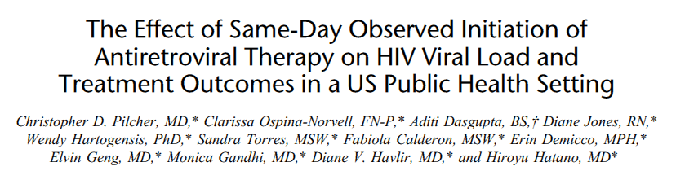
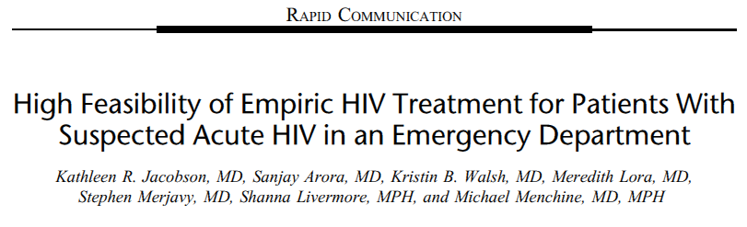
ART is being initiated earlier and earlier,
sometimes
during
Acute HIV Infection

Slide 24
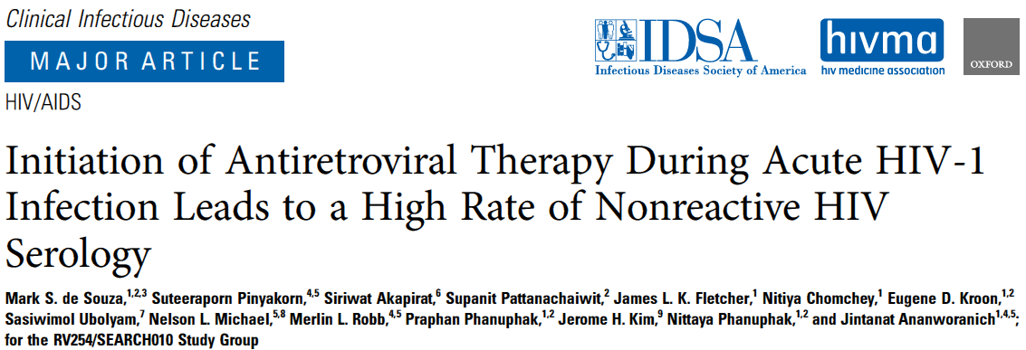
234 patients enrolled in AHI study Bangkok, Thailand
  41 Fiebig I (NAT+ / Ag- / IgM-, IgG-, WB-)
  72 Fiebig II (NAT+/ Ag+/ IgM-, IgG-, WB-)
  92 Fiebig III (NAT+/ Ag+/ IgM+, IgG-, WB-)
  19 Fiebig IV (NAT+/ Ag+/ IgM+, IgG-, WB ind)
  10 Fiebig V (NAT+/ Ag+, IgM+, IgG+, WB+ without p31)

Slide 25
Antibody Response to HIV (without treatment)
- Keating et al CID, 2016

Slide 26
Effect of ART during Acute HIV
gag
(p24)
env
(gp41)
pol
(p31)
- Keating et al CID, 2016

Slide 27
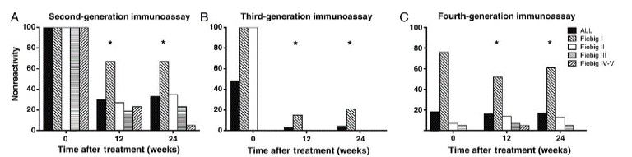
Initiation of ART During Acute HIV Infection Leads to a High Rate of Nonreactive HIV Serology
33%
4%
17%
More reactive by 3rd than 4th gen
All reactive by 3rd gen
All
RNA+, p24 -, IgM -
4th gen performance similar to 2nd gen
RNA+, p24+, IgM -
De Souza et al CID, 2016

Slide 28


Antigens in 3rd gen and 4th gen antibody assays differ
gp41, p24 antibodies
gp41 antibodies

Slide 29

On the Horizon…

Slide 30
HIV-1/2 antigen/antibody immunoassay
(+)
(-)
Negative for HIV-1 and HIV-2 antibodies and p24 Ag
HIV-1/HIV-2 antibody differentiation immunoassay
HIV-1 (+)
HIV-2 (-)
HIV-1 antibodies detected
HIV-1 (-)
HIV-2 (+) HIV-2 antibodies detected
HIV-1 (+)
HIV-2 (+) HIV antibodies detected
HIV-1 (-) or indeterminate
HIV-2 (-) or indeterminate
HIV-1 NAT
(+) indicates reactive test result
(-) indicates non-reactive test result
NAT: nucleic acid test
HIV-1 NAT (+) Acute HIV-1 infection
HIV-1 NAT (-) Negative for HIV-1

Slide 31
HIV-1/2 antigen/antibody immunoassay
(+)
(-)
Negative for HIV-1 and HIV-2 antibodies and p24 Ag
HIV-1 RNA viral load
HIV-1/HIV-2 antibody differentiation immunoassay
Detectable
Undetectable
(99.6%)
HIV-1 (+) HIV-2 (-)
HIV-1 (-) HIV-2 (+)
HIV-1 (+) HIV-2 (+)
HIV-1 (-) or ind HIV-2 (-) or ind
Treat
HIV infected
2nd Ag/Ab assay
Add’l NAT
(+)
(-)
Uninfected

Slide 32
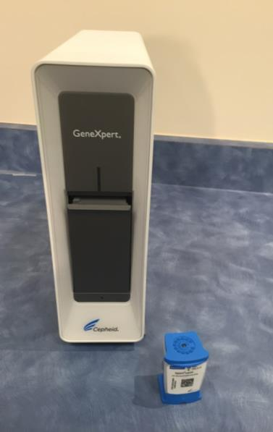
“Point-of-Care” Nucleic Acid Tests
Xpert HIV-1 viral load
  1 ml plasma
  Results in 90 minutes
  LOD 32 copies/mL
  CE-marked December 2014
Not yet available in U.S.
GeneXpert

Slide 33
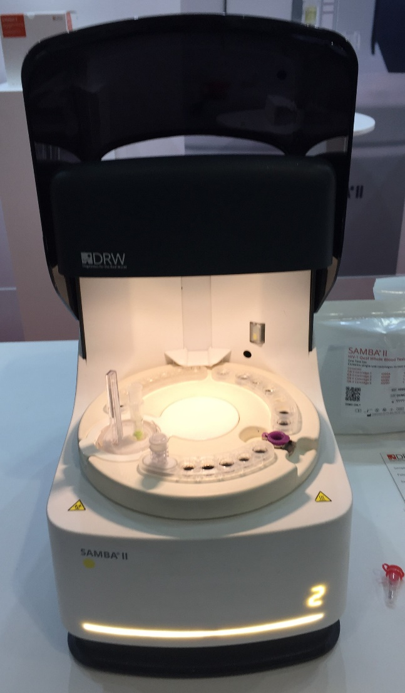
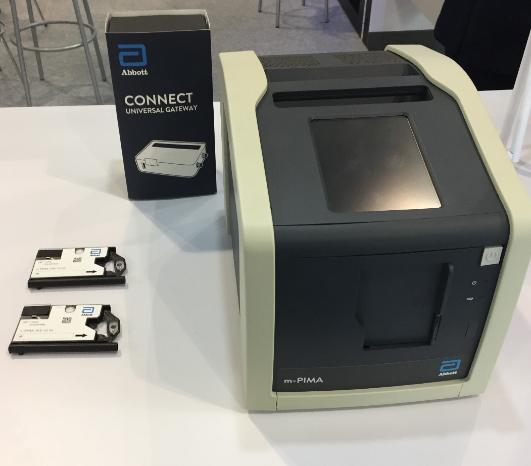
“Point-of-Care” Nucleic Acid Tests
SAMBA II
m-PIMA

Slide 34
Summary
HIV tests differ in subtle ways that affect different circumstances
RNA & viral load will play an increasingly important role in HIV diagnosis
Early treatment (and PrEP) can lead to non-reactive serology and undetectable RNA
  New techniques (such as whole blood total nucleic acid) are needed.

